Slide 1
A Dog’s Life
Proposal for Website

Slide 2
Site Map
Home Page
Grooming Services
Map to Store
Contact Information
How to Select a Good Pet

Slide 3

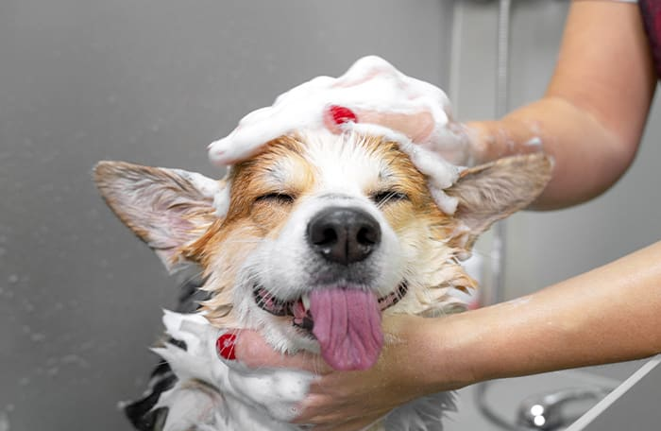

Home Page
A Dog’s Life
GROOMING SERVICES
GROOMING SERVICES
MAP TO STORE
CONTACT INFORMATION
Providing a clean and happy life for your pet
The staff here is focused on improvement, working each and every day to learn something new and evolve with your wonderful pets. All the animals that stay with us have a great time and are reluctant to leave when their stay is over!
Reviews From Customers
Great service, friendly people!
Amy M.
My dog has never been so fluffy!
Parker J.

Slide 4
Grooming Services

Slide 5
Grooming Services

Slide 6
How to Select a Good Pet

Slide 7
Map to Store

Slide 8
Contact Information

